Slide 1
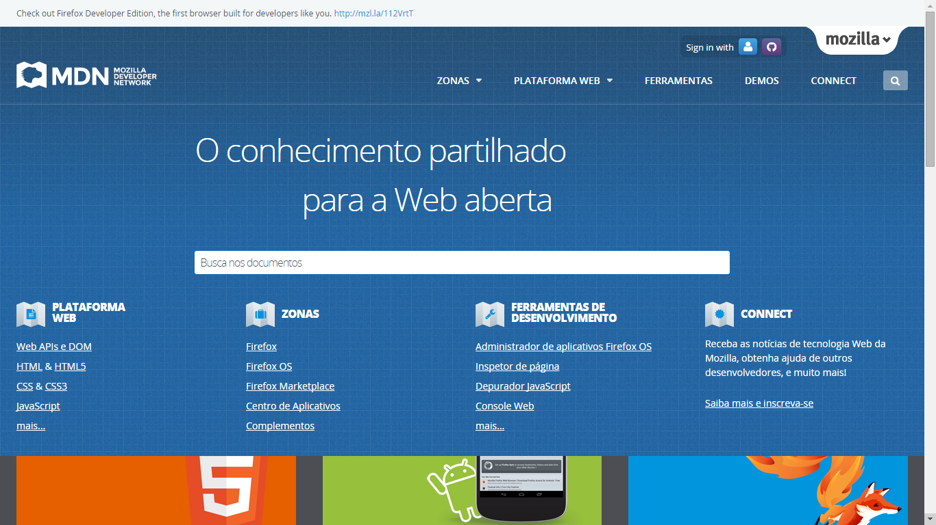
https://developer.mozilla.org/pt-BR/
https://developer.mozilla.org/pt-BR/Firefox_OS

